Slide 1
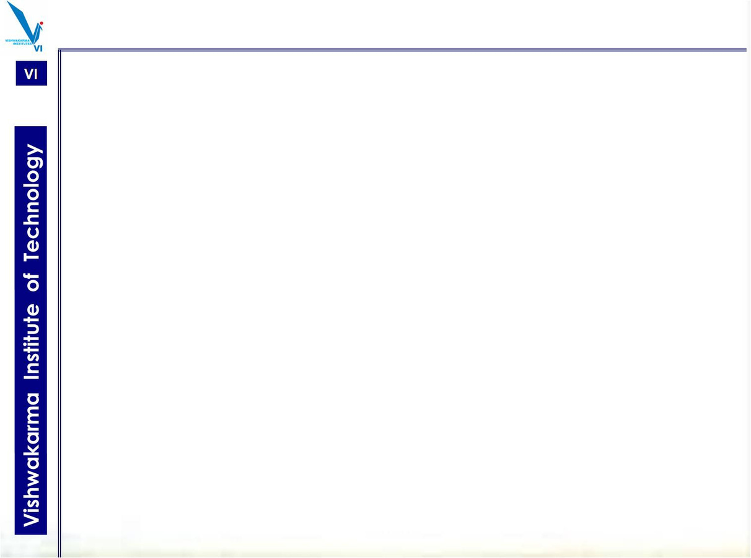


VISHWAKARMA INSTITUTE OF TECHNOLOGY, PUNE
DEPARTMENT OF COMPUTER SCIENCE AND ENGINEERING (ARTIFICIAL INTELLIGENCE)
A.Y 2025-26 SEM (I)
TITLE:
Graph Arithmatic Explorer
SY - CSAI-A
GROUP NO: 02
GUIDE NAME: Dr. Shraddha Mankar

Slide 2
GROUP MEMBERS
1) Sakshi Auti - 12310201, 10
2) Pranav Bagade - 12311134, 13
3) Gaurang Wankhade -12311287, 34
4) Aditya Kulkarni -12311055, 58

Slide 3

INTRODUCTION
  Graphs are an essential data structure in computer science used in networking, pathfinding, and data relationships.
  Understanding how graph algorithms work can be difficult using only theory.
  This tool provides an interactive interface to visualize algorithms dynamically.
  It bridges the gap between theory and practical understanding of algorithms.

Slide 4
Objectives
  To create and edit graphs using a graphical interface.
  To simulate algorithms step by step (manual or automatic mode).
  To display algorithm pseudocode and data structures in real-time.
  To provide performance metrics – time taken, complexity, number of steps.
  To allow comparison of multiple graph algorithms on the same graph.

Slide 5
Technologies Used
  Frontend:
  HTML5: Structure of the web page and content.
  Tailwind CSS: For styling and responsive UI using utility classes.
  JavaScript: Main logic for drawing, running algorithms, and interactivity.
  Canvas API: Used to draw and animate the graph elements dynamically.
  Additional Design Details:
  Smooth gradients and hover effects using Tailwind.
  Responsive layout for both large and small screens.
  Lightweight, runs entirely in the browser – no backend required.

Slide 6
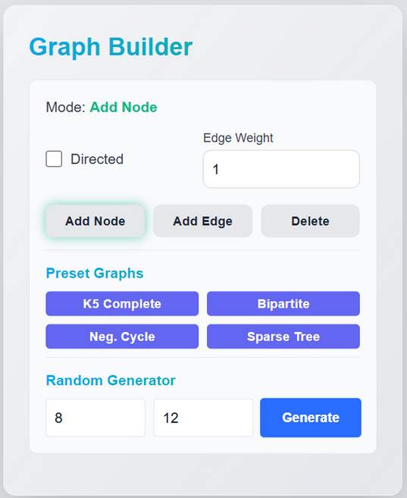
Key Features
Interactive Graph Builder:
  Add or delete nodes and edges
easily by clicking on the canvas.
  Choose directed or undirected graphs.
  Assign weights to edges for weighted
algorithms.
  Load preset graphs like Complete (K5),
Bipartite, or Sparse Tree.
  Generate random graphs by specifying
number of nodes and edges.

Slide 7
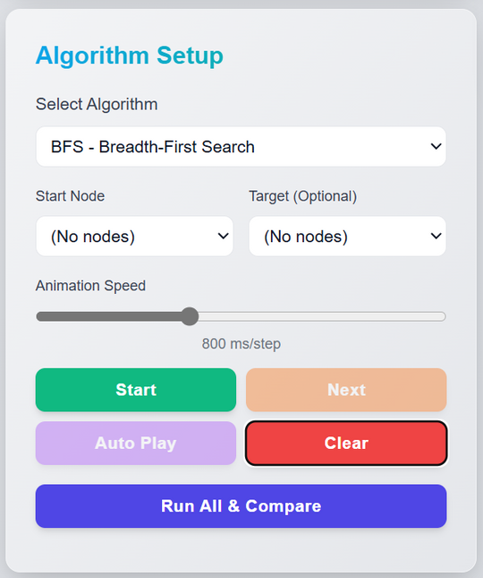
Key Features
Algorithm Setup & Control:
  Select any algorithm (BFS, DFS, Dijkstra,
etc.) from the dropdown.
  Choose start and target nodes.
  Control speed using a slider.
  Use Next Step, Auto Play, and Reset
buttons.

Slide 8
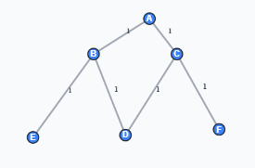
Algorithms Implemented
Pathfinding Algorithms:
  BFS (Breadth-First Search): Explores nodes level by level.
  DFS (Depth-First Search): Explores as deep as possible before backtracking.
  Dijkstra’s Algorithm: Finds shortest path with non-negative weights.
  Bellman-Ford Algorithm: Handles negative weights; detects negative cycles.
Minimum Spanning Tree Algorithms:
  Prim’s Algorithm: Builds MST by expanding from a starting vertex.
  Kruskal’s Algorithm: Sorts all edges and connects components.
All-Pairs Shortest Path:
  Floyd–Warshall Algorithm: Computes shortest paths between all vertex pairs.

Slide 9
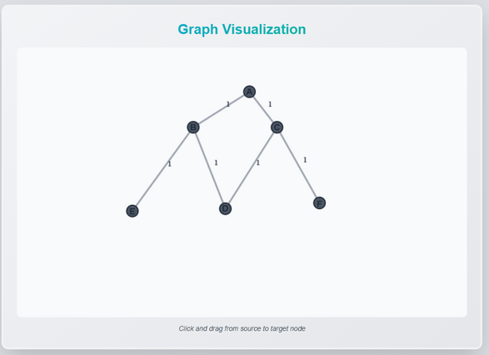
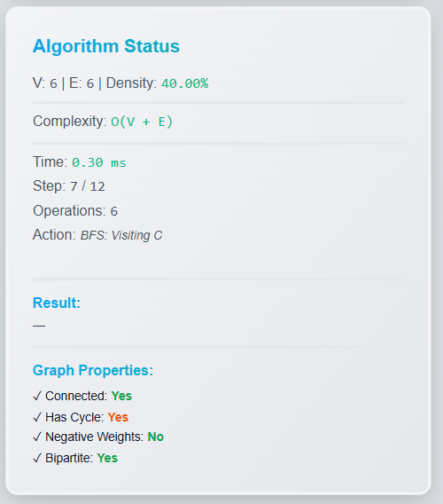
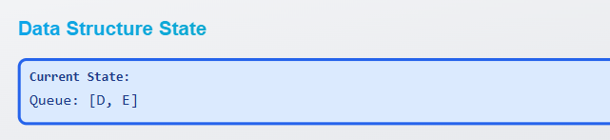
Visualization

Slide 10
Conclusion & Future Scope
Conclusion:
  The project helps users visualize and understand complex graph algorithms easily.
  It provides both educational and practical insight into algorithm behavior.
  Improves learning experience through interactive exploration.
Future Enhancements:
  Add A* and Topological Sort algorithms.
  Enable saving and loading graphs (JSON format).
  Show real-time complexity graphs.
  Deploy as a web application accessible to students worldwide.

